Slide 1

Scotty, Mike, Michael, Janet, Giovani, Seana

Slide 2
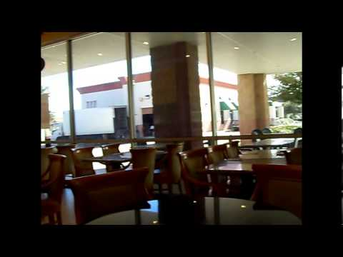
Notes:
Located in Plano, previously Richardson at Spring Creek and Independence
Serves Northern Chinese food
Founded by Mr. Chang and his wife
Mr. Chang worked in IT for 30 years, layoffs caused them to consider starting a restaurant
Mr. Chang and his wife are both Muslim, wanted to serve Muslim-friendly meats

Slide 3
Halal
Islamic law
Similar to Kosher
No pork
Specifies:
How animals slaughtered
Methods used
Processing of meat
Notes:
Islamic law
Similar to Kosher
In cases where Halal meat is not available it's possible for a Muslim to eat Kosher
No port
Specifies how animals slaughtered
Methods used
How the meat is processed

Slide 4
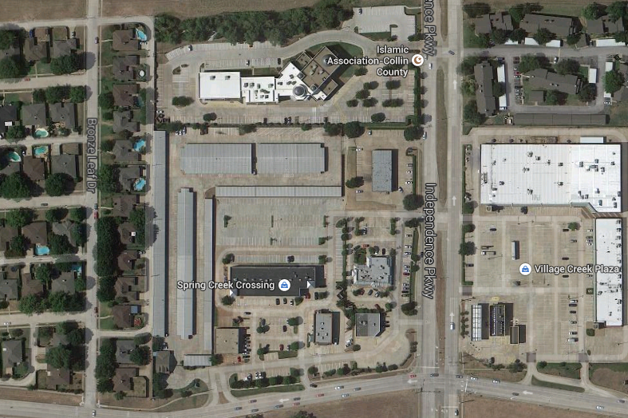
Clientele Estimates
90% clients Muslim
5% Muslims in Plano
Many non-Muslims nearby
Notes:
Hard to find data on religion with existing market data
Mr. Change estimates about 90% of clients are Muslim Muslim population is small enough in Plano that there isn't a lot of research
Found 2 mosques in Plano, one West, one East (others not in Plano)
Best info we found gave 80% Christian (Catholic + Protestant) and 20% "other" without breaking down other
5% is a close estimate
In comparison there are so many Christian churches in Plano there's almost one on every corner

Slide 5
Competition (Halal Chinese)
Bamboo Garden (4.9 mi)
Masala Wok (4.9 mi)
Bombay Chopstix (6.8 mi)
Kung Pow Asian Diner (11.3 mi)
Many focus on Indian-Chinese fusion
Crescent Moon is traditional Chinese
Notes:
As you can see, Muslims usually have to drive far to get food to eat
However, these restaurants are all generally Indian-Chinese fusion
Incorporating things like curry into traditional Chinese menus
Crescent Moon, however, is as traditional Chinese as possible
Normally, traditional Chinese food incorporates pork
Had to change many entrees to make them Muslim-friendly
Can't mix non-Halal meat with Halal meat
This is a weakness, compared to say, normal Chinese restaurants.
They simply can't offer pork

Slide 6
Analysis
Niche market
Close to mosque
Mosque parking lot in back of restaurant
Restaurant runs volunteer activities at mosque
Mosques function as social centers like churches
Primarily word of mouth
Important in Muslim community
Saturated market?
Notes:
Niche market
Close to mosque
Mosque parking lot in back of restaurant, there's even a sign saying the restaurant is Halal
Restaurant runs volunteer activities at mosque
Mosques function as social centers like churches especially for a smaller community
Primarily word of mouth
Important in Muslim community
Saturated market?

Slide 7
Business Data
All transactions, receipts in paper
Hard to measure
Number of clients
Repeat clients vs. new clients
Change over time and day to day
Lack understanding in market position
Business is profitable, stable
Notes:
All transactions, receipts in paper
Hard to measure Number of clients, Repeat clients vs. new clients, Change over time and day to day
Lack understanding in market position
What we do know is that, currently business is profitable, stable

Slide 8
Conclusion
Muslim market may face diminishing returns
Lots of work, less benefit, more expensive
Go after the bigger slice of the pie
Any promotions aimed at non-Muslims will still act as a reminder for Muslims
If it fails, still gained very useful data
Notes:
Going after the Muslim market may face diminishing returns
It will be a lot of work to go after who is left, and there will be less benefit
Plus it'll be more expensive, the last few people left are going to be the hardest to reach
So instead, why not go after the bigger slice of the pie?
Of course, our segment isn't just "non-Muslims," that's a bit too big to work with
We'll tailor our plan so that any promotions aimed at non-Muslims will still work as a reminder for Muslims
By making improvements to measuring our customers, not only will we know if this works, we'll gain useful info along the way about what customers want
So even if we fail, we still gained very useful data we don't have now
Throughout we'll still have the normal Muslim crowd to bring home the bacon, or in this case the beef, chicken, and shrimp
Alright, that's the plan. Now, let's look at the competition.

Slide 9
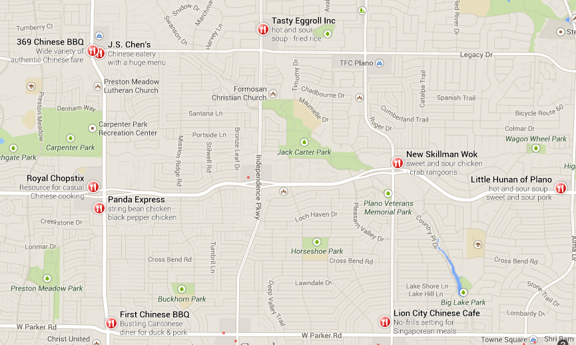
Competition
Notes:
(pause)
Well, there's just a few Chinese restaurants out there.
As you can see, there's a lot of competition.
This leads us to our problem

Slide 10
Problem
How can Crescent Moon, a restaurant normally focused on Northern Chinese meals with Muslim-friendly practices, expand into a crowded market of Chinese restaurants?
Notes:
How can Crescent Moon expand into this new, crowded market of Chinese restaurants?

Slide 11
Differentiation
Authentic Northern Chinese
Sans pork
Chinese breakfast
Good for Muslim customers too
Open late
Gourmet Chinese tea and coffee
Notes:
First we need to have a way to differentiate Crescent Moon from the dozens of Chinese restaurants nearby
We already have talked about the food being authentic instead of being a fusion of other cultures
We were fortunate that Mr. Chang shared with us some info on future plans he had which we were able to basically work backward from
By starting with what makes Crescent Moon stand out we can easily find our target segments
Chinese breakfast is a concept that practically doesn't exist in most of America
I can't even find a Chinese restaurant that opens before 10 or 11
Being open early benefits Muslim customers.
Halal restaurants are usually open for lunch and dinner.
Crescent Moon recently changed their hours so that they're open until midnight on weekends
Again, this just isn't common for Chinese restaurants
Finally, they have plans to offer gourmet Chinese tea and coffee, which we think works well with the late night crowd especially

Slide 12
Target Segments (Psychographic)
Early morning workers
Breakfast before work
Late-night
Students, young adults
Asian-Americans
Especially immigrants and Chinese
Respond to authenticity
Notes:
First, we'll have to admit that going after the standard lunch and dinner crowd is going to be extremely difficult.
Instead, we'll use the differentiation as a framework for our restaurant
Early morning workers, people who wake up early, like to eat breakfast before work or school
Late night is going to concentrate mostly on students and young adults
About 35% of Plano is under 24, which provides for the late night crowd.
Finally, Asian-Americans
This is normally not a Psychographic segment, however we think the authenticity of Crescent Moon's food will attract people who are either immigrants or simply raised in the Chinese culture
And culture and beliefs are part of Psychographics
By having an authentic Chinese breakfast which is basically not served anywhere else, we can introduce these people to Crescent Moon
Hopefully they will come in later for lunch and dinner

Slide 13
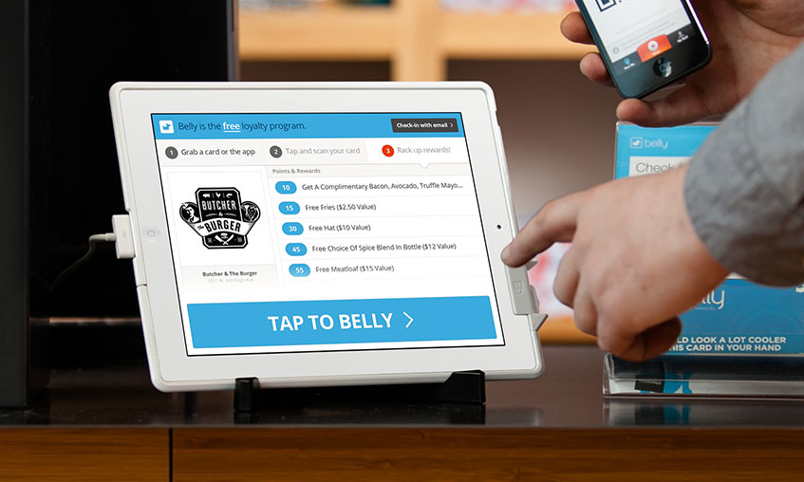
Belly
Notes:
Belly is a loyalty program that Crescent Moon uses.
You sign up either through their phone app or using a small card available in the store.
Every time you come in, you hold your card up to this iPad at the desk and you accumulate points.
After so many points, you can redeem them for free stuff, such as small entrees or desserts.
However, we think the power behind Belly comes not from getting your customers to return but from its ability to provide data on your customers and market to them via email
Every time someone uses Belly it reports that and provides info on whether this was a new customer or a return customer among other things
Because Crescent Moon still uses paper for transactions, this provides valuable info on whether the promotional strategies are working without having to spend thousands on a Point of Sale system
We can also send emails to customers through Belly, for example sending coupons to a customer that hasn't checked in recently to convince them to come back

Slide 14
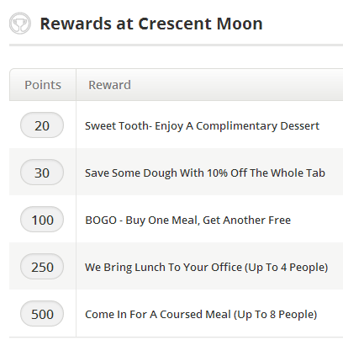
Belly
Have staff tell customers
More small rewards
Less big rewards, make them personal
Table signs
Notes:
As part of our promotion mix, we want to encourage customers to use Belly more so that we can get better data and use the email marketing feature
When checking out, a waiter could ask if the customer has used the Belly loyalty program, and give them instructions on how to use it
Don't state the big rewards up front, it diminishes the feeling of having accrued enough points to get the normal rewards
I've been to a burrito restaurant called Freebirds plenty of times and racked up tons of points on their in-house loyalty program, but I rarely redeem them
It's a bit of pride honestly to save them, and when the cashier rings me up and sees I'm a regular customer next time they often recognize me and treat me better
Instead, make the rewards low and relatively attainable
250 points here means you've visited 50 times, and at that point you should instead be inviting your customers personally and offer them these incentives at no cost just for being good customers
And finally, we suggest having table signs, which I'll get to in a bit

Slide 15
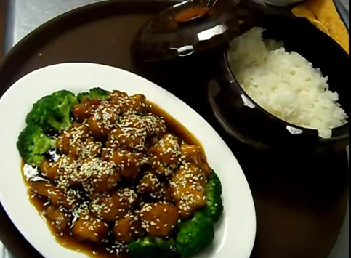
Menu
Incorporate pictures into menu
Include small section on what Halal is
Contingencies for shortages
"Sesame Chicken"
Notes:
The menu is pretty standard for a Chinese restaurant
There's a lot of entrees with the usual "B1", "C2" designation but no pictures!
Pictures would really help your customers choose what they want, especially if they're new
If the pictures are good, it's also very likely more people will buy those items
Use this to your advantage and put pictures for the high margin items!
We think there should be a small section on what Halal is
It's not just about educating your clients about what your restaurant offers, but helping them understand the different cultures of other customers
One thing about Halal meat is that sometimes there's shortages of certain types because there's less supply
It's really pretty jarring for a waiter to come up to your table to take your order, you ask for say "sesame chicken" but then they say "oh, sorry, we don't have chicken"
We recommend having some kind of alternate menu, or some kind of insert you can put in your menu that has an apology, says "we're out of chicken," and maybe suggests popular items in other meats

Slide 16
Specials
Try new menu items
Inform customers
Menu insert
Table sign
Waiter/waitress
Record customer interest
Notes:
I love to watch Food network and be an armchair judge of course, but the dishes at Crescent Moon honestly look good, they're very artfully arranged
The chef at Crescent Moon seems like a good chef, so I recommend giving him the option to come up with new menu items
If he's a good chef he'll definitely appreciate it and hopefully will come up with entrees that customers may love
Once you have these specials, you have to inform your customers
A common method is through menu inserts, where the normal menu has a smaller piece of paper inside
Table signs, which we'll talk about next
And training the waiters and waitresses to suggest these specials to customers
Finally, even with paper, record how many specials you sell, have the waiters tick off on a steno pad every time someone orders one

Slide 17

Table Signs
Specials
Facebook
Twitter
Belly
Shortages
Menu changes
Etc
Notes:
I've mentioned table signs a few times, so I want to make sure we all know what they are
They're these little things that a lot of restaurants have
These are pretty critical to make the rest of the promotion mix work well
For example, when your customers are waiting for their food they could go like your Facebook page, or download the Belly app and sign in
It also keeps your customers a little less bored if the wait is long

Slide 18
Late-night
Gourmet tea and coffee
Happy Hour
½ off drinks after 10
2$ off if you buy 2 drinks after 10
Free coffee with tea, vice versa
Price drinks high enough that you still make profit or come close
Notes:
Gourmet tea and coffee is itself its own promotion
We recommend a happy hour promotion
If customers are coming in and buying lots of food late at night, the happy hour deals could be even better
½ off drinks after 10
2$ off if you buy 2 drinks after 10
Free coffee with tea, vice versa
However, one key thing is to price drinks high enough that you still make profit or at least come close
This way you can keep the promotion going for a long time and your regulars will appreciate it
For example, Sonic runs a happy hour from 2 to 4 pm where drinks are half off
They get a nonstop stream of customers during this period yet the drinks are still priced to make a tidy profit

Slide 19
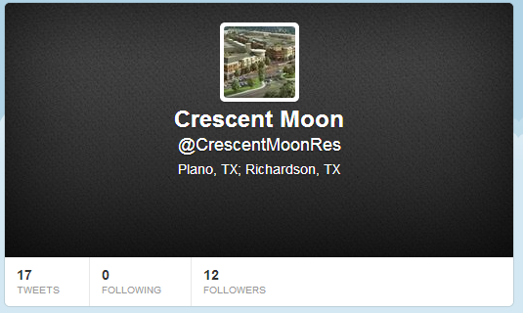
Internet
Website
Facebook
Twitter
Yelp/Zabihah/etc
@CrescentMPlano ?
Notes:
One approach Crescent Moon is lacking is their online presence.
For example, the website still has the Richardson location listed, which closed down a few months ago
Definitely not good if a customer tries to go there!
The hours are also out of date
95% of the time I go to a restaurant's website to find their locations and hours
The other 5% I go to see the menu
On Facebook, there's two automatically-generated pages for the Plano and Richardson location.
These places have over a thousand different people who've checked in to the restaurant
There's an official page, but it hasn't been updated since 2011
All these opportunities are being missed
Crescent Moon does have a Twitter that has some updates, but they're pretty infrequent
If you don't have a smartphone Mr. Chang, get one and put it as a business expense
If a really good-looking plate of food goes out the kitchen, take a picture real quick and post it online
I'm sure we've all had the experience where we're wondering what to eat when we see something on Facebook and thank "man, that sounds good"
Make the page more active and people will notice it!
As for Yelp, Zabihah, and all the other restaurant aggregation websites,
Google Crescent Moon every month and make sure that all these websites have the right hours, the right location, the right menu
Make sure that your customers can easily find out about your restaurant

Slide 20
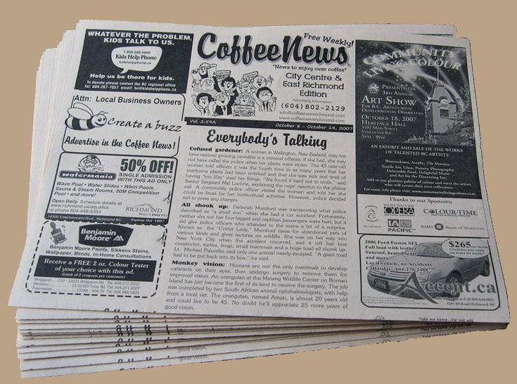
Advertisement
Small and local
Plano newspaper: Plano Star Courier
CoffeeNews
Stress unique qualities, promotions
Notes:
Everything before has been stuff that is either very cheap or free
Just a matter of mitigating risk, entering a new market
CoffeeNews, a weekly publication
Unique qualities, like the gourmet tea and coffee, Chinese breakfast, or late night food
Don't want people to look at the ad and think "oh, another Chinese place"

Slide 21
Projections
Short-term
Regular customers come in more often
Few new customers
Minimal financial impact
Long-term
Regular customers as normal
Many new customers
Notes:
Short-term
Regular customers come in more often
Few new customers
Minimal financial impact
Long-term
Regular customers as normal
Many new customers

Slide 22
Implementation
Monitor customer feedback
Analyze repeat/new customer data
Find what works through experimenting
Look at the restaurant like and how a customer would and see what can be improved
Notes:
Monitor customer feedback
Analyze repeat/new customer data
Find what works through experimenting
Look at the restaurant like and how a customer would and see what can be improved

Slide 23
Looking Back
Effects on Crescent Moon

Slide 24
New Food
New coffee bar and espresso machine
Serves many types of coffee
Not Chinese-focused, instead more Americanized coffee
New sushi bar, open on certain days
New staff hired to run this

Slide 25
Late-night
Restaurant now closes later
Midnight on most days
Kitchen closes at 11 p.m.
Reduced staff at night
Still hard to find hours without asking

Slide 26
New Menu
Menus are improved
Contains new selections like coffee
Sushi insert, only put it on sushi days
Better layout
Less spelling mistakes
Still not many pictures

Slide 27
Unimplemented
Belly
Belly was not more prominently featured
Paper receipts
Still missing customer data
Website
Still has closed Richardson restaurant listed
Old hours
Advertising

Slide 28
Effects
Business is still great
Hard to find a table most days
Focus seems to be on adding higher margin items for existing customer base
Working well

